Slide 1
Appium installation guide

Slide 2
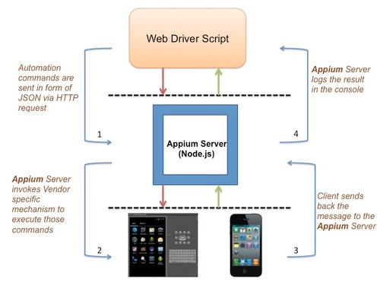
Introduction
Appium is a test automation framework for use with native, hybrid and mobile web apps.
How it works?
Appium is an Http server written in node.js which creates and handles multiple WebDrivers sessions for different platforms like IOS, Android and Windows. Appium starts a “test case” on the device that spawns a server and listens for commands from the main Appium server.

Slide 3
Advantages
Free and open source
Cross-platform
No need for app source code
No need to reinstall or recompile the app
Support multiple frameworks and programming languages
Wide and active community

Slide 4
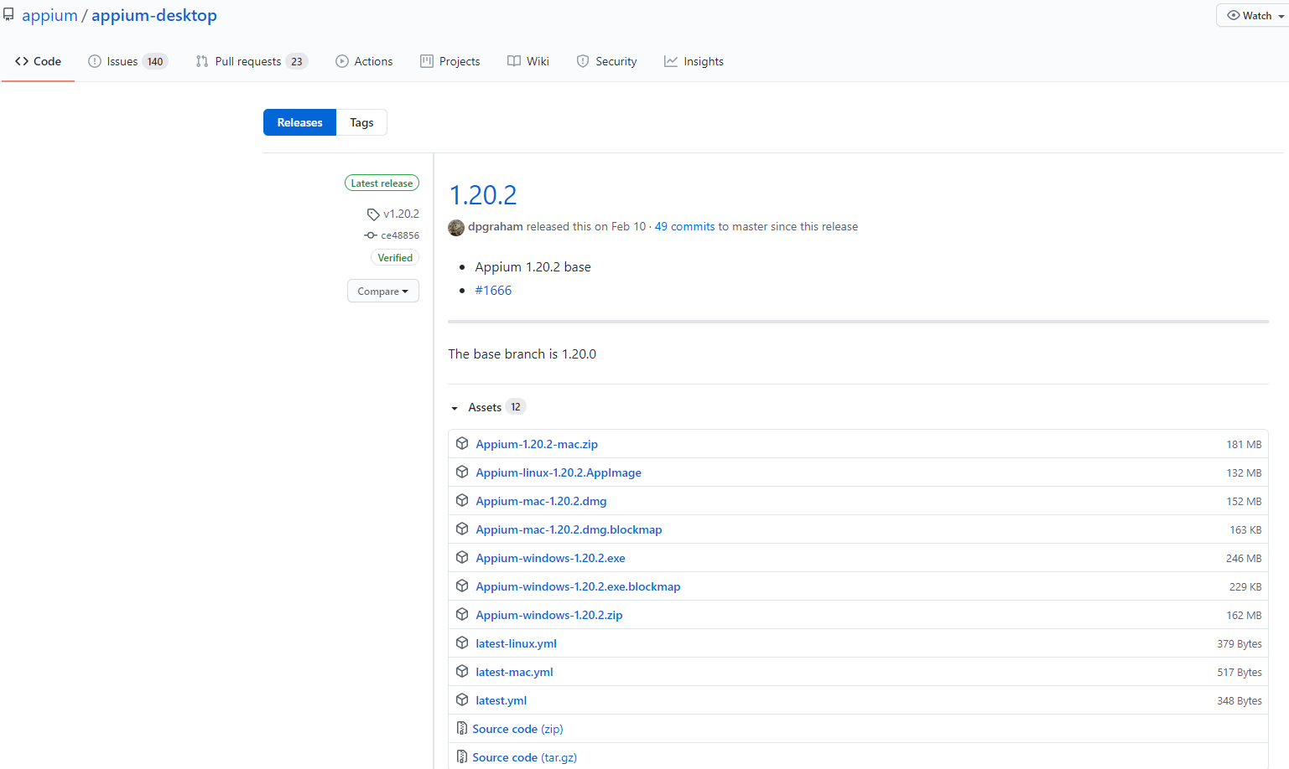
Install Appium Desktop
Go to https://appium.io/
Click Download Appium
The next github repository
will open ➔
Choose the installation file based on your os
For windows download the windows .exe file marked in red
Open the file and install Appium desktop

Slide 5
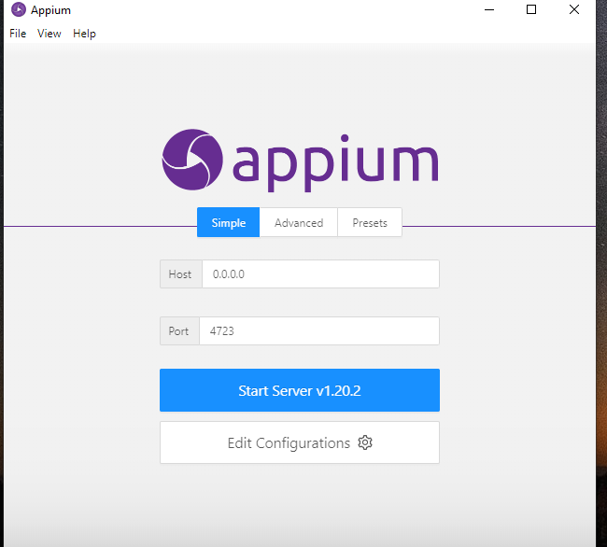
Install Appium Desktop
The installation is simple.
Appium will ask you if to install for specific user or all users, you can choose based on preferences.
After the installation you will see the following window ➔
We will return to it later

Slide 6
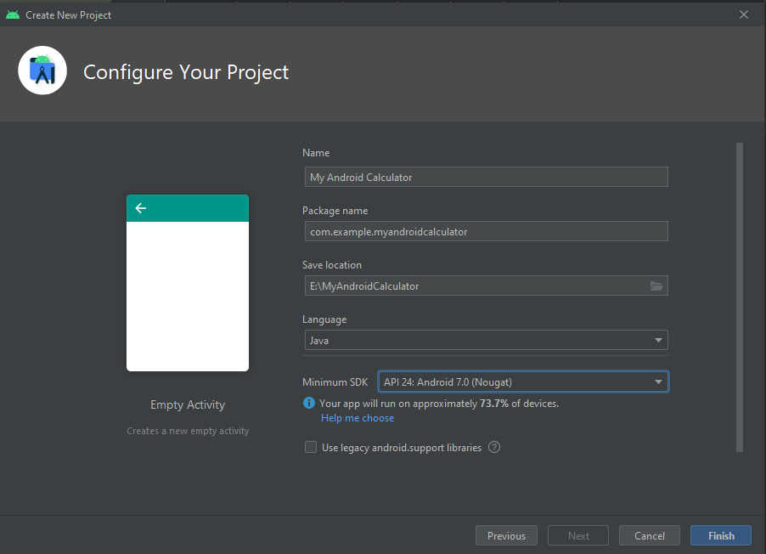
Create Android Calculator
First we will create simple calculator project on which we will run few tests.
Appium supports versions 4.3 and greater of Android.
Notes:
c

Slide 7
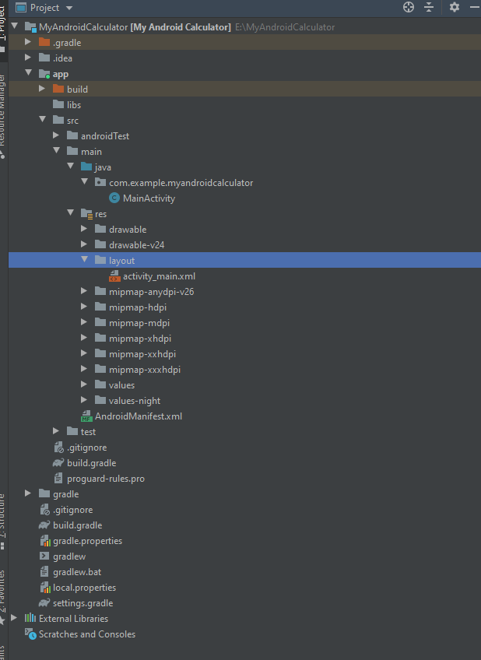
Create Android Calculator
In the new created project we will edit two files:
1. MainActivity File- https://github.com/Mark6197/Appium-Demos/blob/main/MyAndroidCalculator/MainActivity.java
2. activity_main.xml- https://github.com/Mark6197/Appium-Demos/blob/main/MyAndroidCalculator/activity_main.xml
The calculator app is ready and you can run it on the emulator.
Notes:
c

Slide 8
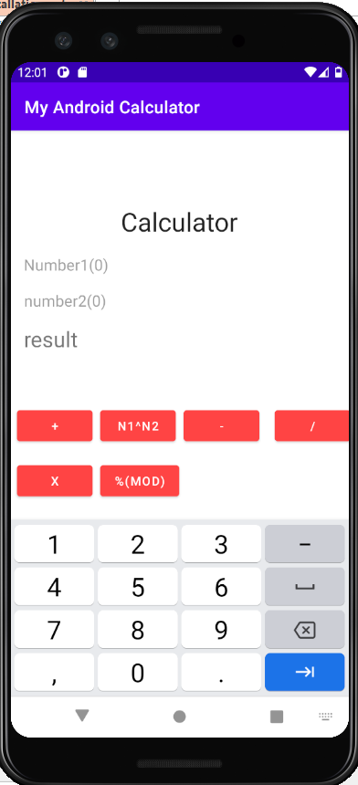
View of the calculator app

Slide 9
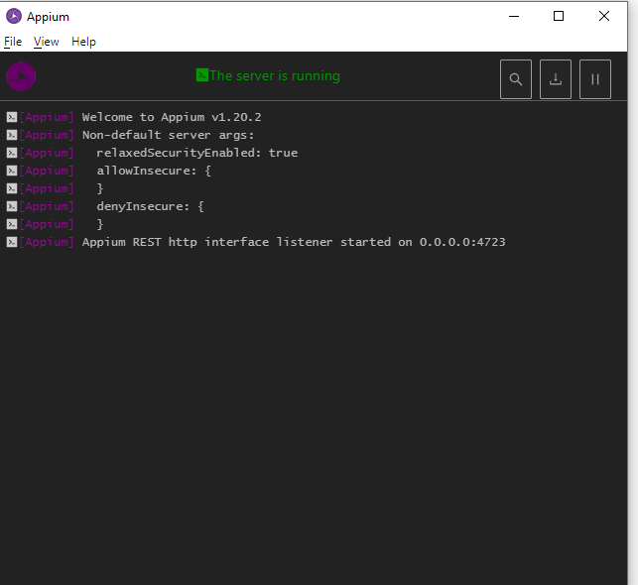
Appium server
Going back to the 5th slide, open Appium desktop and run Appium server. You can run the server with the simple default configurations
When the server will lunch you will see the following window ➔

Slide 10
Appium server
Going back to the 5th slide, open Appium desktop and run Appium server. You can run the server with the simple default configurations
When the server will lunch you will see the following window ➔
Click on the magnifying glass

Slide 11
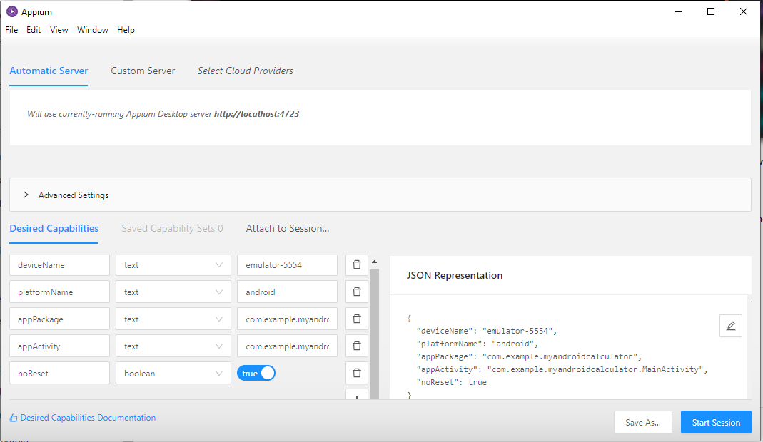
Appium desktop
You will see the below window. There are few capabilities that we will add on the left. Appium will generate JSON representation of them and display it on the right. There are additional capabilities that we can configure on Appium.
The device name which is running and will be tested on.
The platform on which we are running. Can be android or ios.
The name of the package of the application that we testing. It is also the application id.
The name of the activity that we are testing in the application.
Determines whether reset the application each time we are running the tests.

Slide 12
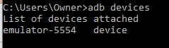
Where to find all those names?
First of all, the application should be installed on the emulator that will be up and running. You don’t have to run the emulator from the same project that contains the source code. In fact you can download an application from the app store and run tests on that application.
deviceName- Open the cmd and enter the following command: adb devices You will see the list of devices attached
Name of the device

Slide 13
Where to find all those names?
platformName- That is pretty simple, we are running on android so the name is android.
noReset- That is also pretty simple, since we don’t want to reset the application each time we are testing it, we should assign it to true.
appPackage- If you are having access to the source code you can find the application id which is also the package name in the build.gradle file. We will see it in the next slide.
What if you don’t have access to the source code? You can get the
appPackage by a cmd command together with appActivity.

Slide 14
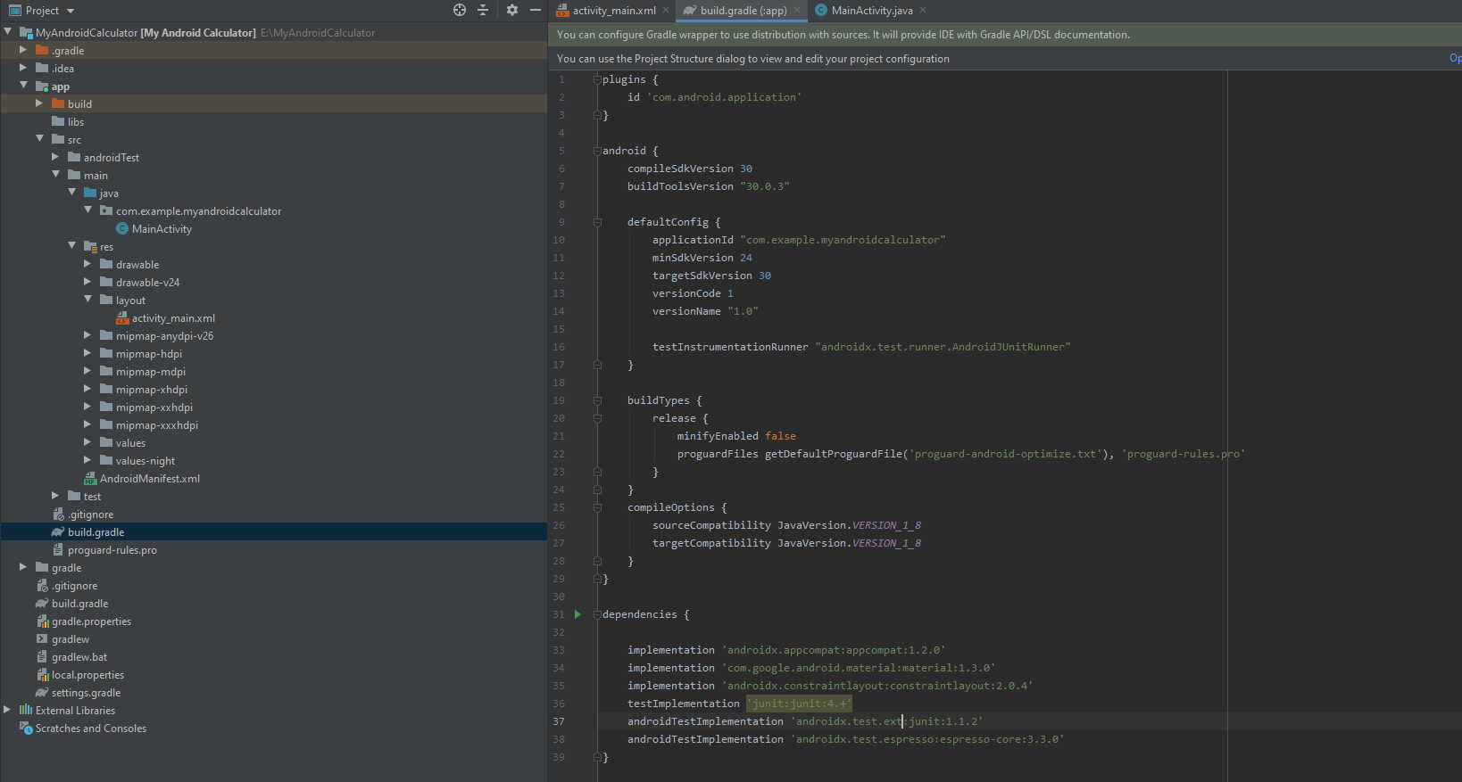
Where to find all those names?
The package name
build.gradle file

Slide 15
Where to find all those names?
appActivity (and appPackage)- First, make sure that the emulator is running and the desired app and activity are open on the screen. Open the cmd and enter the following command :
For windows: adb shell dumpsys window | find "mCurrentFocus"
For Linux/Mac: adb shell dumpsys window | grep -E 'mCurrentFocus'
Before the / character is the appPackage
After the / character is the appActivity

Slide 16
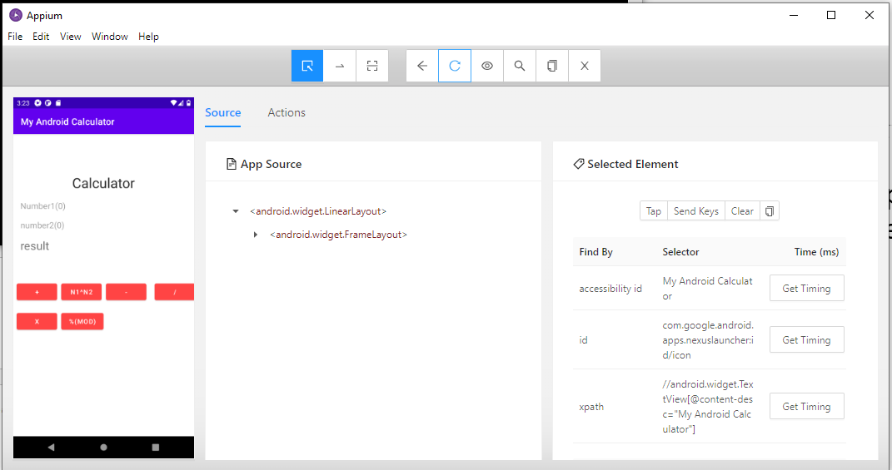
Test Android Calculator
After setting the desired capabilities you can click start session
When the session starts you will see that the Appium reopens the application on the emulator and you will also see the below window

Slide 17
Appium Desktop
In the previous slide Appium has opened a new window with the same display as on the emulator.
Actions that are done on the Appium emulator session are also done on the Android Studio emulator but that won’t work in the other direction.

Slide 18
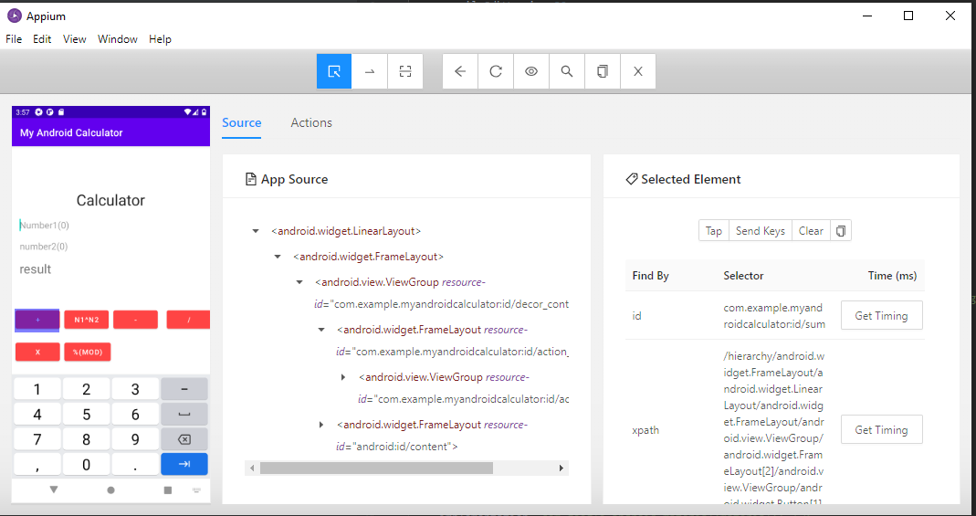
Appium Desktop- Quick Overview
Swipe by coordinates
Select Elements
Refresh source & screenshot
Copy XML
Quit
Back
Search element
Record
Selected element details
Click
Appium’s emulator
App source XML tree

Slide 19
Select element
You can select different elements on the screen by clicking on the select elements button or by clicking on the element in the XML tree
The details of the last selected element are displayed on the right. The details are split into two sections:
Find by- id or xpath. Display the selector that are used to find the element. You can also test each of them to check how quick the element has been found (Usually id is faster).
Attributes- such as index, text, enabled, clickable with their values.
You can make different actions on the selected element such as click, send text, clear.

Slide 20
Select element
Send text to the selected element
Clear the element
Click on the selected element
Copy Attributes
Get the time that it takes to find the element by it’s id
Get the time that it takes to find the element by it’s xpath

Slide 21
Swipe by coordinates
You can simulate a swipe by using Swipe by coordinates button.
Then click on the start and end points of the swipe.
This can be used to check swipes in our application for example: swipe for closing a menu.

Slide 22
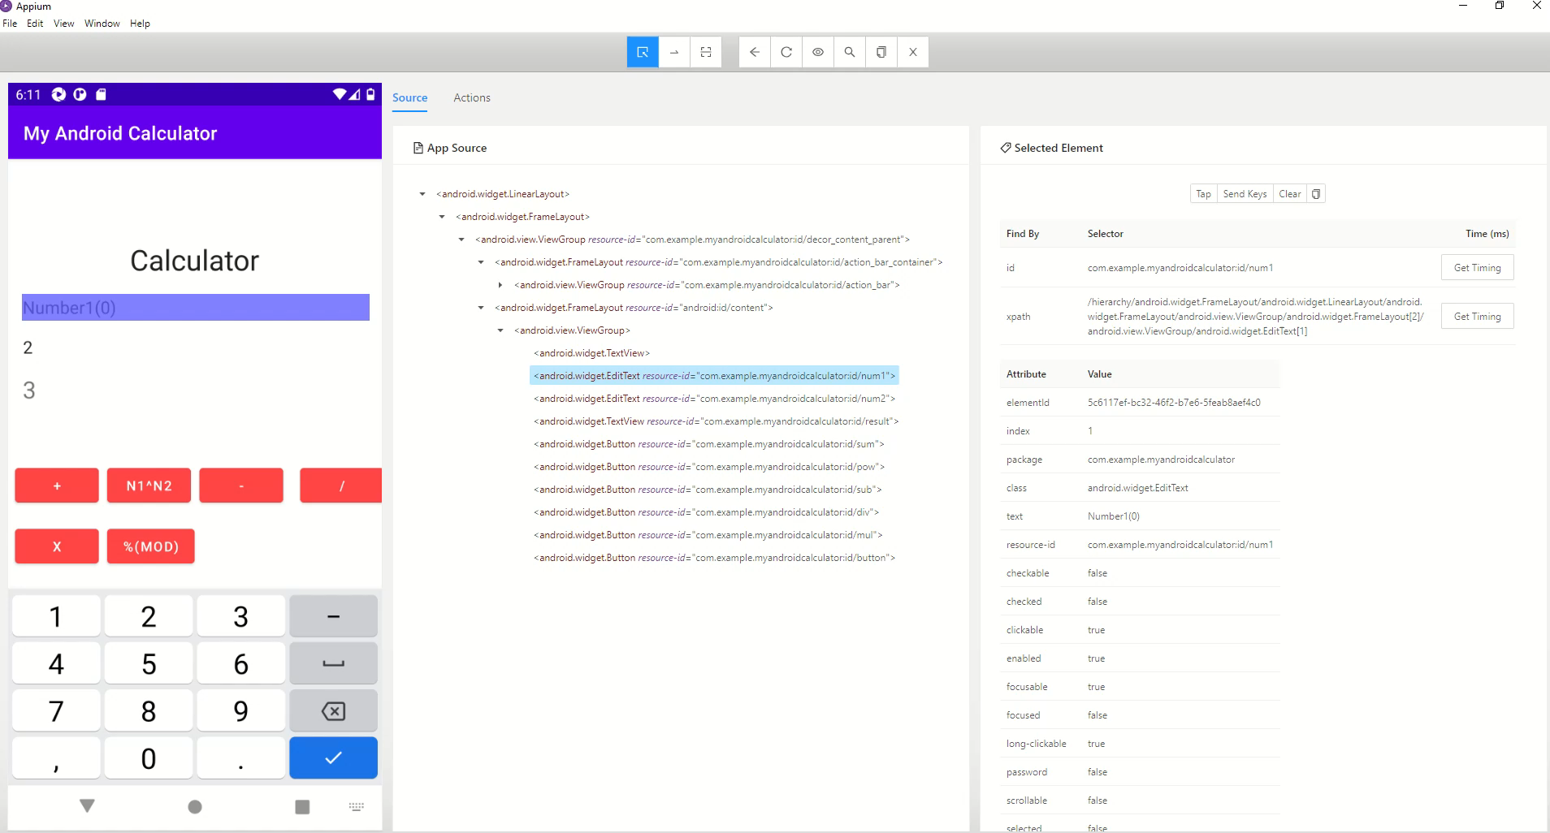

Slide 23
Tap by coordinates
You can simulate a click by using Tap by coordinates button.

Slide 24
The recorder
Very useful tool provided by the Appium Desktop.
The recorder allows to make a set of actions on the emulator that will then translate them to code that we can use for testing.
The code that is generated can be in different programming languages.

Slide 25
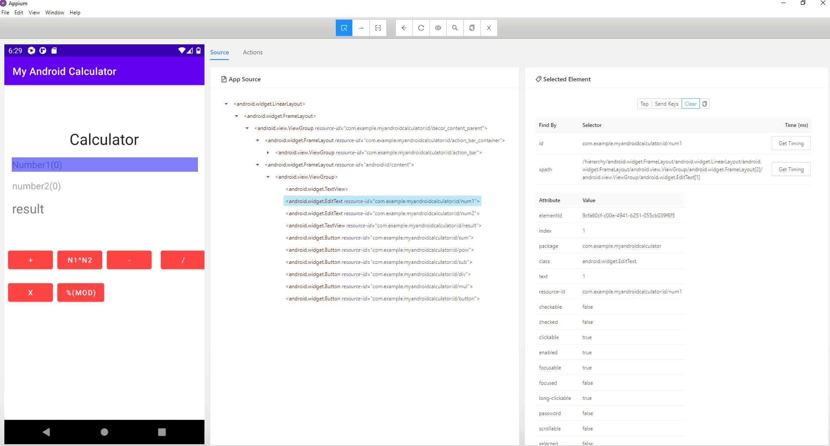

Slide 26
Test Android Calculator
In our demo we will create the tests in a new project with junit 5.4.2 using Intellij Idea
Create libs folder that will be used for the Appium and selenium libraries.

Slide 27
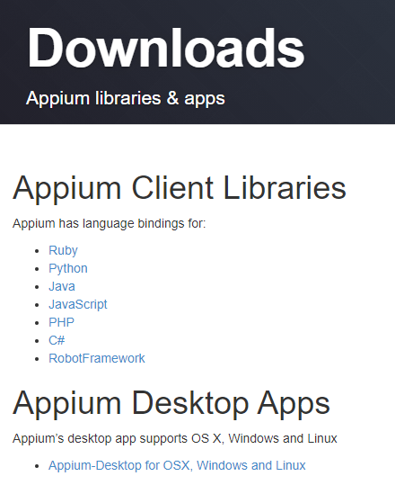
Install Appium Client Library
Go to https://appium.io/downloads
Choose the java Appium client library

Slide 28
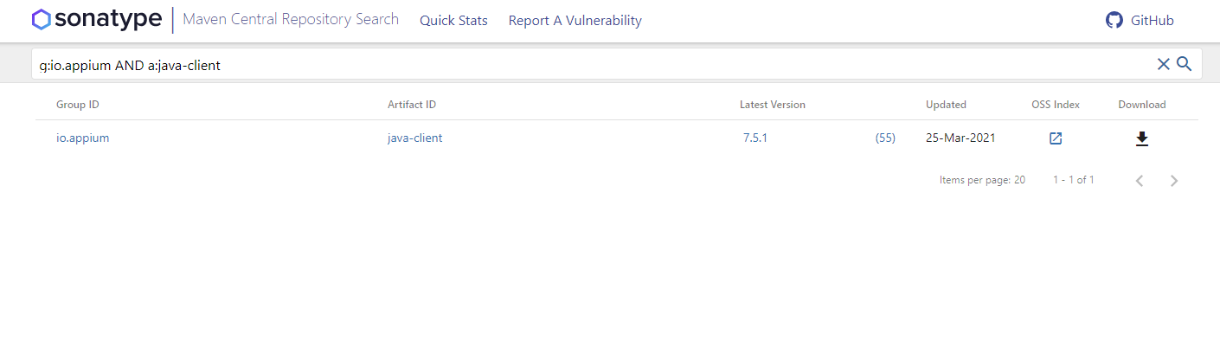
Install Appium Client Library
Click on download

Slide 29
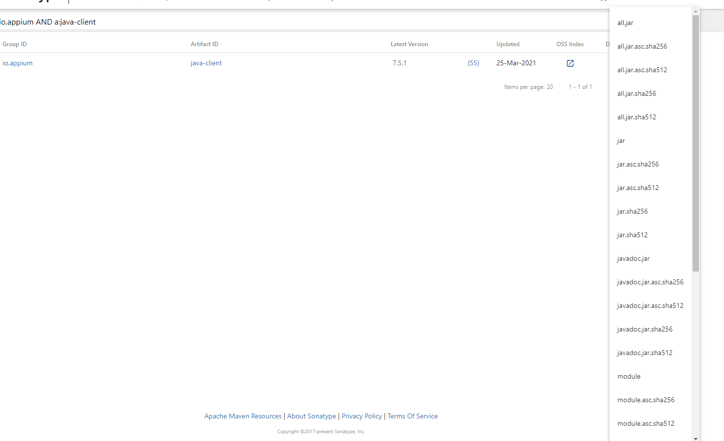
Install Appium Client Library
Download the jar file
You will see that a file named:
java-client-7.5.1.jar
was downloaded
*7.5.1 is the version and probably will change in the future

Slide 30
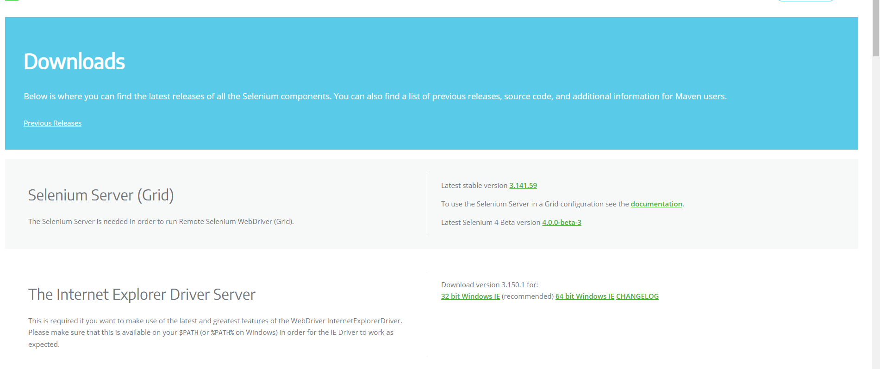
Install selenium
https://www.selenium.dev/downloads/
Download the selenium standalone server (also known as grid)

Slide 31
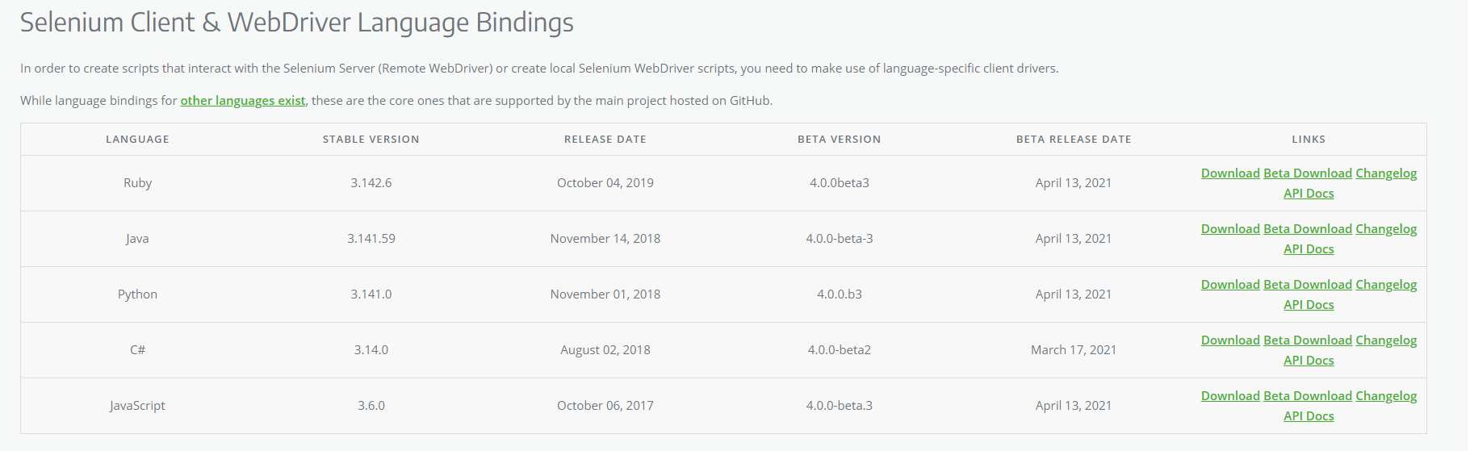
Install selenium
https://www.selenium.dev/downloads/
Download the java client

Slide 32
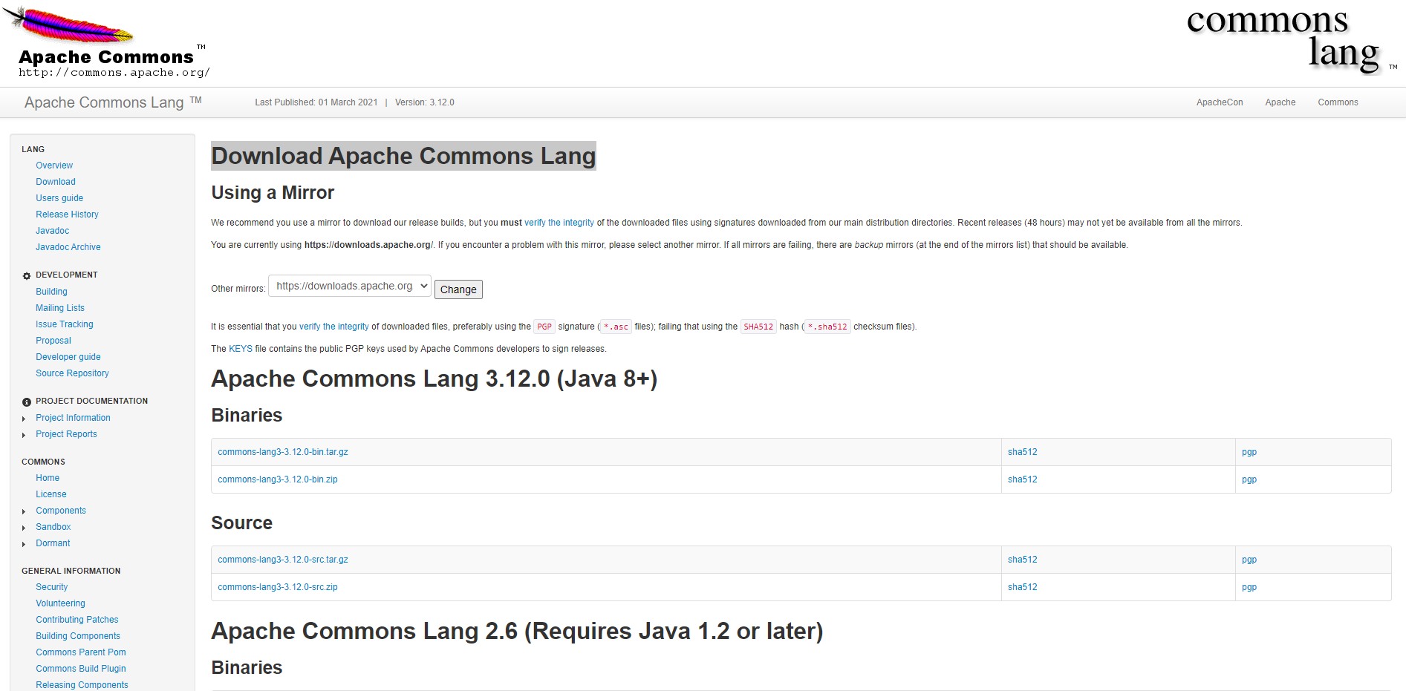
Download Apache Commons Lang
https://commons.apache.org/proper/commons-lang/download_lang.cgi
Download the zip file

Slide 33
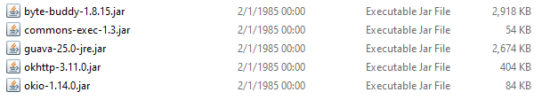
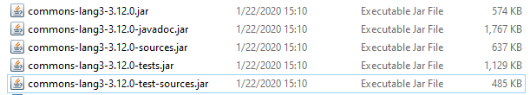
Add the libraries to the tests project
First add the Appium client library
Then add the selenium standalone server
Then add the files from the libs folder of the selenium java client
Finally add the Commons Lang jar files
Mark all the files and add them as a global library

Slide 34
Test Android Calculator
After we added all the files that are needed we can start and write our tests.
Example for simple tests on the calculator with Appium and Junit: https://github.com/Mark6197/Appium-Demos/blob/main/MyAndroidCalculatorAppiumTests/CalculatorTests.java

Slide 35
Test Windows Application
Appium has the ability to test windows desktop application (Universal Windows Platform- UWP, Windows Forms- WinForms, Windows Presentation Foundation- WPF, and Classic Windows- Win32) but have few requirements:
Windows should be windows 10.
You need to have permissions to run the Appium (Desktop or CLI) as Administrator. (I tried to run it as a regular user and it worked)
Developers Mode must be on.

Slide 36
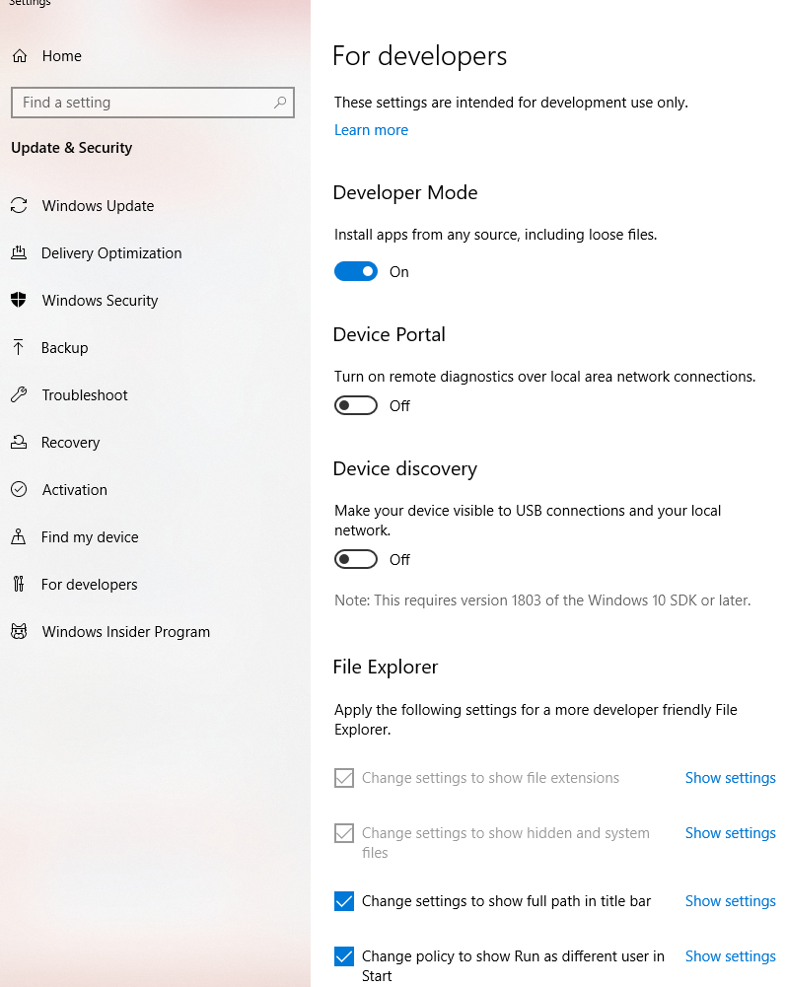
Turn on developers mode
https://docs.microsoft.com/en-us/windows/apps/get-started/enable-your-device-for-development
Enter "for developers" into the Cortana search box in the taskbar
Enable Developer Mode

Slide 37
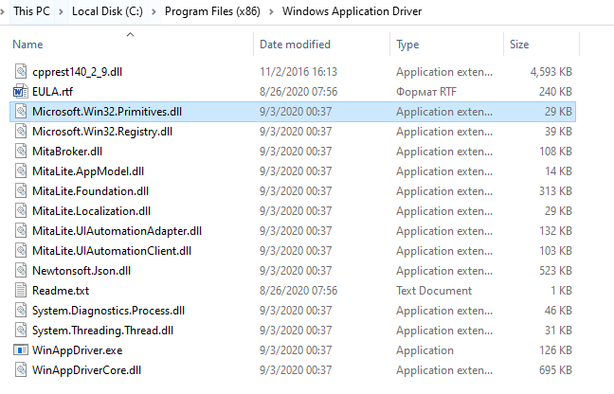
Windows Application Driver
Check if the WinAppDriver is installed on your computer.
You can simply check it by navigating to the folder:
C:\Program Files (x86)\Windows Application Driver
The folder should look like this ➔
If the folder doesn’t exist or if it is empty
follow the instructions on the next slide

Slide 38
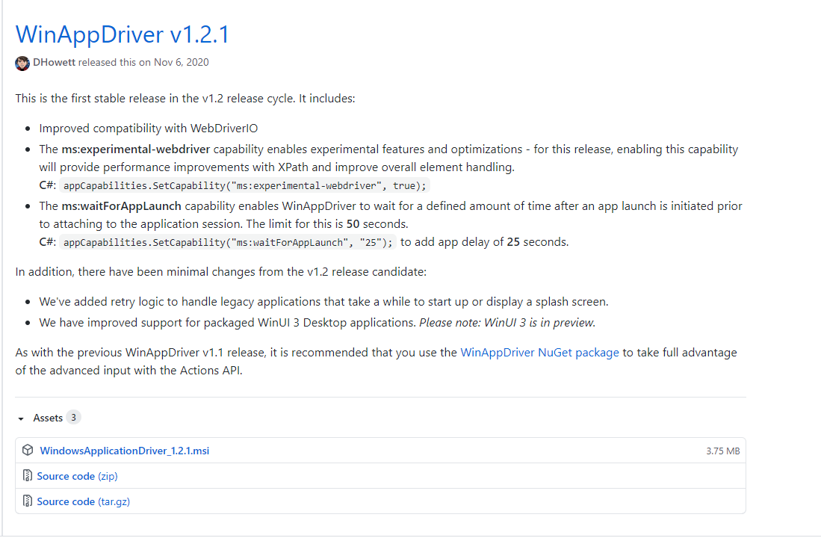
Windows Application Driver
https://github.com/Microsoft/WinAppDriver/releases
Download the msi file and install in the following path
C:\Program Files (x86)\Windows Application Driver

Slide 39
Appium Desktop for windows applications
You can run Appium desktop and open the application just like we did with the android app but it won’t be helpful. You won’t be able to make actions such as click and send keys and you won’t be able to inspect the elements. The recorder won’t work either. We will see in the next slide.

Slide 40
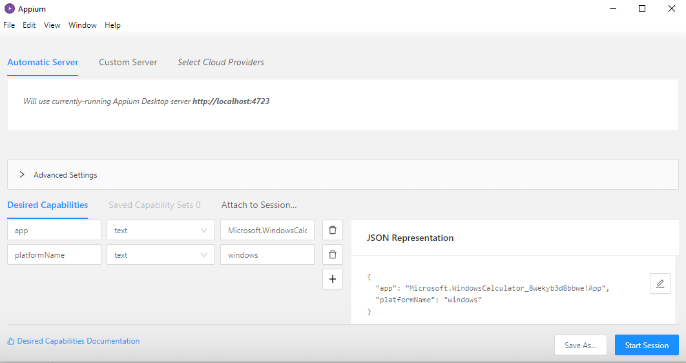
Appium Desktop for windows applications
We will try and open the Windows calculator with Appium desktop.
Fill the following desired capabilities and click start session
The app id (you can see the full id in the JSON representation)
The platformName in this case is windows

Slide 41
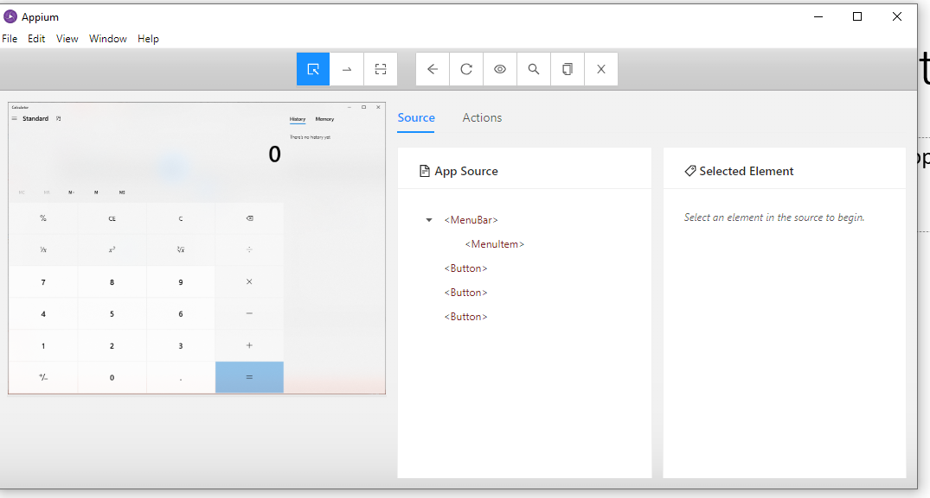
Appium Desktop for windows applications
After clicking on start session you will be able to see that the calculator app has been opened.
Also you will see the following window
In the element tree you will notice that you can’t see the calculator elements. And clicking on them won’t do much.
So how can we inspect the elements?

Slide 42
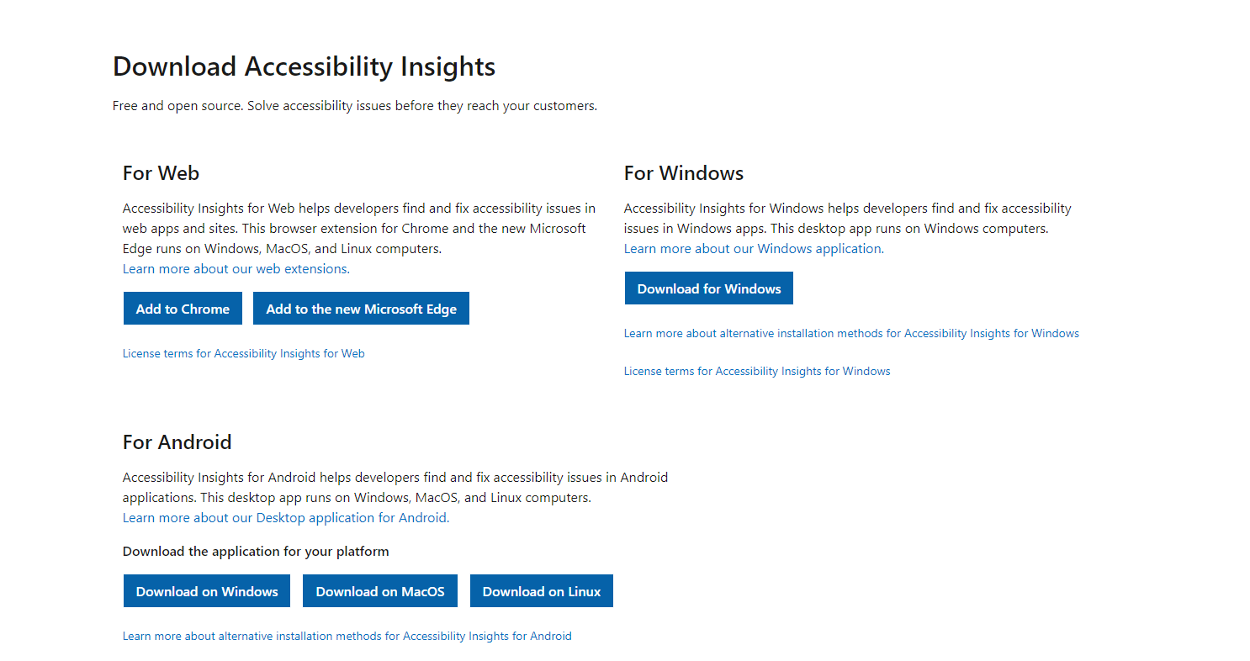
Accessibility Insights
https://accessibilityinsights.io/en/downloads/
Download and install For Windows

Slide 43
Accessibility Insights
There are other version of Accessibility Insights for Android and for the Web.
With this tool you would be to inspect the properties of different elements such as name, id (you will see it as automation id), isEnabled etc...
https://www.youtube.com/watch?v=BIu9ONdMGGg - Short introduction video

Slide 44
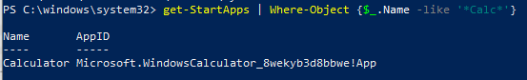
How to get win32 application id?
Open PowerShell
Navigate to the directory in which the application sit in our case the command would be: cd c:\windows\system32
Use the following command:
get-StartApps | Where-Object {$_.Name -like '*Calc*'}
Note that the calc is the name of the execution file of the calculator app.

Slide 45
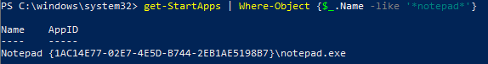
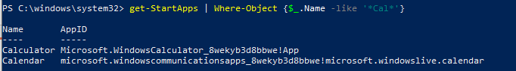
How to get win32 application id?
Another example is searching the notepad id:
get-StartApps | Where-Object {$_.Name -like '*notepad*'}
You don’t have to specify the full name. you can specify only cal instead of calc but it might return a few options for this:

Slide 46
How to test the application with code?
We will create a new project with junit 5.4.2 using Intellij Idea
We will repeat the same steps as we did with the Android app:
Create libs folder and do the exact same steps as in slide 33
We will build a simple Hello world test on a wpf application
Source code: https://github.com/Mark6197/Appium-Demos/tree/main/WpfApp3
Exe file: https://github.com/Mark6197/Appium-Demos/blob/main/WpfApp3.exe
Test code: https://github.com/Mark6197/Appium-Demos/blob/main/WpfTests/WpfTests.java
The source code isn’t required for the tests, only the exe file is required.

Slide 47
Microsoft Calculator Tests
The original tests are an example provided by Microsoft:
https://github.com/microsoft/WinAppDriver/blob/master/Samples/Java/CalculatorTest/src/test/java/CalculatorTest.java
This is code a little old and will not run with junit 5.4.2 and the new version of Appium so here is the refactored code:
https://github.com/Mark6197/Appium-Demos/blob/main/MicrosoftCalculatorTests/CalcTests.java
Note that you will need all the files in the lib folder just like in the previous example.

